Slide 1
Namespaces
CS 201, Summer 2013

Slide 2
ADDITIONAL READING
Namespaces
  Chapter 11 of Pearson book
  http://www.learncpp.com/cpp-tutorial/711-namespaces/

Slide 3
Namespaces
When you write C++ applications, usually you will use one or more library.
A library is pre-written code, either by yourself or somebody else.
Some libraries handle:
  GUI (Graphical User Interface)
  3D Rendering
  Filesystem Handling
  Etc.

Slide 4
Namespaces
There is a ton of libraries for C++ (and C) that you can use!
Because of this, namespaces exist.
Namespaces help us explicitly differentiate what comes from what library.
Namespaces also keep us from having naming conflicts – such as if two libraries both have a “Setup” function.

Slide 5
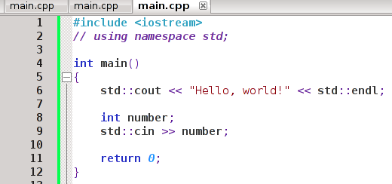
using namespace std;
If we don't use a statement like using namespace ___, then we have to specify a namespace every time we use functionality from that namespace.

Slide 6
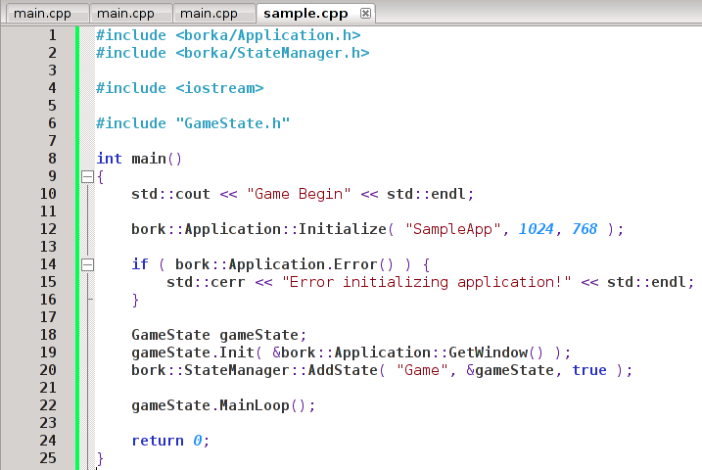
Using multiple libraries
Standard C++ library namespace
“bork” library namespace
Things without a namespace are part of this program

Slide 7
We can create our own namespaces
We can build our code into programs (.exe), or we could build our code into libraries (.dll for example)
We can use namespaces to encapsulate our functions & classes that might belong to a special set of functionality.

Slide 8
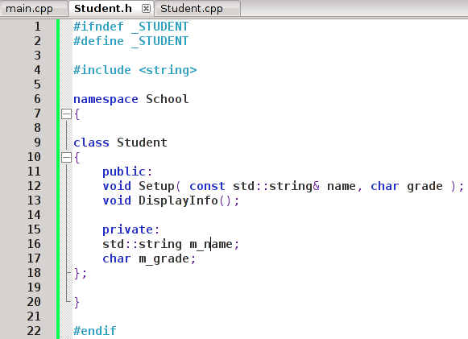
We can create our own namespaces
Namespace begin
Namespace end
To create a namespace, we surround code with a
namespace ________ statement & curly-braces

Slide 9
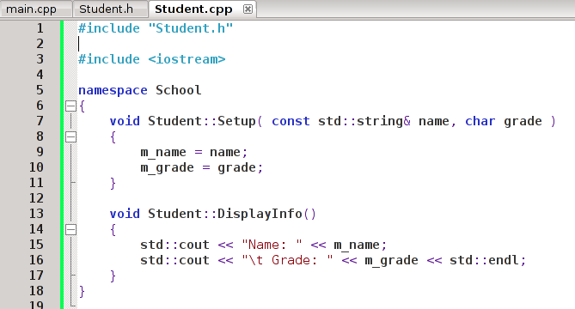
We can create our own namespaces
The related functions in the .cpp file must also be surrounded by the namespace.

Slide 10
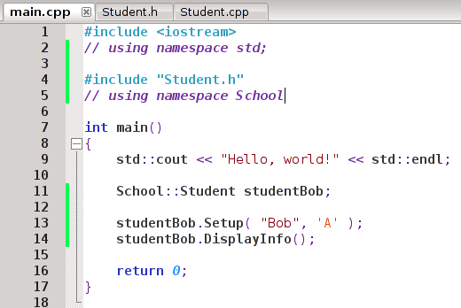
We can create our own namespaces
And when we use the Student class, we need to prefix the data-type with the School:: namespace.

Slide 11
We can create our own namespaces
Once a variable is declared, we don't need to prefix the variable-name. We've already specified the data-type belongs to the namespace.

Slide 12
That's It!
In Java you'll see namespaces like
“com.[business].[program]”
If you feel like a part of the program is logically separate from the rest (ie, “Billing”, “Routing”, …) you might create a namespace for it.

